Slide 1

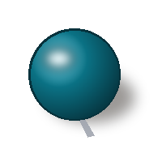

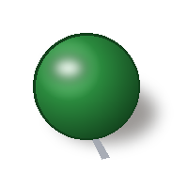
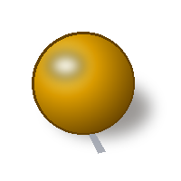
Water Quality Index Development of
Jhajjar Distributary Region
Hydrochemical Characterization, WQI Modeling & Irrigation Suitability Assessment
Methodological Framework: Grounded in Islam, Sinha, Hussain et al. (Nature Scientific Reports, 2025)
B.TECH FINAL YEAR PROJECT (MIDTERM)
INVESTIGATION TEAM
Varsh Ranga • Krishna Tyagi • Lakshya Phalaswal
Aditya Ojha • Sushil
Department of Civil & Environmental Engineering
PROJECT SUPERVISOR & GUIDE
Prof. Athar Hussain
Professor & Head, Department of Environmental Engineering
Senior Author, Nature Scientific Reports (2025)

Slide 2
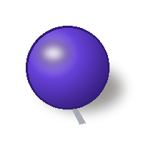
Introduction: River Water and Groundwater
Surface Water vs. Groundwater Dynamics
• Fed by rainfall, runoff, canals and distributaries
• Exposed to sewage, industrial waste and agricultural runoff
• Quality changes with season and flow
• Stored in aquifers; used through tube wells and hand pumps
• Contaminated by natural sources (e.g. fluoride) and human activity
• Recharges slowly, so pollution stays for a long time
RIVER / SURFACE WATER
GROUNDWATER
A Water Quality Index (WQI) combines many parameters into a single score to judge water for drinking and irrigation.

Slide 3
Water Quality Parameters & Significance
Key Physicochemical Indicators of Jhajjar Distributary
Parameter | Significance & Health / Environmental Impact
pH | Acidity or alkalinity of water; affects taste, mineral solubility, and plumbing corrosion
TDS (Total Dissolved Solids) | Indicates total salinity and dissolved inorganic salts; determines drinkability
Total Alkalinity (TA) | Ability of water to neutralise acid; primarily bicarbonate (HCO₃⁻) and carbonate (CO₃²⁻)
Total Hardness (TH) | Caused by multivalent metallic cations (mainly Ca²⁺ and Mg²⁺); causes scale formation
Calcium (Ca²⁺) | Derived from sedimentary rock weathering; primary contributor to hardness
Magnesium (Mg²⁺) | Essential mineral, but causes water hardness and laxative gastrointestinal effects at high levels
Sodium (Na⁺) | Adds to salinity and alkali hazard; induces soil deflocculation and impairs soil permeability
Potassium (K⁺) | Liberated from silicate rock weathering and agricultural potash fertilizers
Chloride (Cl⁻) | Imparts salty taste; primary tracer of anthropogenic sewage, saline upconing, and industrial effluent
Nitrate (NO₃⁻) | Originates from agrochemical nitrogen fertilizers and sewage; induces infant methemoglobinemia
Sulphate (SO₄²⁻) | Derived from gypsum deposits and industrial run-off; exerts laxative gastrointestinal effects
Fluoride (F⁻) | Above 1.5 mg/L WHO limit causes endemic dental and skeletal fluorosis

Slide 4
Experimental Methods & Analytical Instrumentation
Laboratory Protocol for Hydrochemical Characterization
• Alkalinity: Neutralization titration with standard sulphuric acid using phenolphthalein and methyl orange indicators.
• Hardness, Ca²⁺, Mg²⁺: Complexometric EDTA titration using Eriochrome Black T (EBT) buffer for TH and Murexide for Ca²⁺.
• Chloride: Argentometric titration with standard silver nitrate (AgNO₃) using potassium chromate indicator.
• Sample Preservation: Samples collected in pre-washed high-density polypropylene bottles after extensive flushing to evacuate stale water.
ANALYTICAL INSTRUMENTATION MATRIX
TITRATION & PROTOCOL NOTES
Parameters Analyzed | Method / Analytical Instrument
Total alkalinity, Total hardness, Calcium, Magnesium, Chloride | Standard Volumetric Titration (Acid, EDTA, AgNO₃)
pH, Total Dissolved Solids (TDS) | Digital Multi-Parameter Kit (Electrochemical Probes)
Sodium (Na⁺), Potassium (K⁺) | Flame Emission Photometer
Nitrate (NO₃⁻), Sulphate (SO₄²⁻), Fluoride (F⁻) | UV-Vis Spectrophotometer (Shimadzu UV-1800)

Slide 5
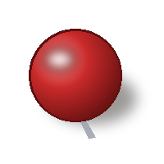
Experimental Methods: 4-Stage Workflow & QA/QC
Standardized Protocols & Precision Quality Control (APHA Guidelines)
Field Sampling & Preservation
• APHA 1060 field collection standard
• Pre-cleaned polypropylene bottles
• Well borehole purging (3–5 min)
• Zero headspace, stored at 4°C
In-Situ Field Probing
• Immediate electrode stabilization
• pH & temperature measurement
• Electrical Conductivity (EC)
• TDS reading prevents equilibrium shift
Standard Lab Assays
• APHA 2320 B: Alkalinity titration
• APHA 2340 C: EDTA Hardness
• APHA 4500-F⁻ D: SPADNS Fluoride
• Shimadzu UV-1800 spectrophotometer
QA/QC & Ionic Balance
• Normalized Charge Balance Error:
• CBE = |ΣCat - ΣAn| / (ΣCat + ΣAn) * 100
• Strict validation threshold: CBE <= +-5%
• Reagent blanks & calibration R² > 0.999
STAGE 01
STAGE 02
STAGE 03
STAGE 04
RESEARCH QUALITY CONTROL BENCHMARK (Hussain et al., 2025): All hydrochemical determinations must pass the Normalized Charge Balance Error threshold of +-5%. Duplicate laboratory titrations and multi-point calibration curves (R² >= 0.999) ensure reproducibility across all distributary reach sections.

Slide 6
Permissible Limits of Parameters & Unit Weights
Regulatory Benchmarks (WHO & IS 10500) and Calculated Wn Values
• Inverse Proportionality: Unit weights (Wn) are computed inversely proportional to permissible standard limits: Wn = K / Sn, where K = 1 / Σ(1/Sn).
• Fluoride Dominance (Wn = 0.620): Because fluoride carries an acute toxic limit of 1.5 mg/L, it commands 62% of the aggregate index weight! Slight fluoride spikes sharply deteriorate overall WQI.
• pH Sensitivity (Wn = 0.109): pH represents the second-highest weight factor due to its regulatory influence on aquatic toxicity and metal mobility.
• Combined Weight Concentration: Together, Fluoride and pH comprise 72.9% of the overall drinking water quality index decision matrix.
Parameter (mg/L) | WHO Limit | IS 10500 Limit | Unit Weight (Wn)
TDS | 1000 | 500–2000 | 0.001
Na⁺ | 200 | – | 0.005
K⁺ | 12 | – | 0.078
Total Hardness (TH) | 500 | 200–600 | 0.019
Ca²⁺ | 200 | 75–200 | 0.005
Mg²⁺ | 50 | 30–100 | 0.019
Total Alkalinity (TA) | 500 | 200–600 | 0.002
pH (unitless) | 8.5 | 6.5–8.5 | 0.109
Fluoride (F⁻) | 1.5 | 1.0–1.5 | 0.620
Chloride (Cl⁻) | 250 | 250–1000 | 0.004
Nitrate (NO₃⁻) | 50 | 45 | 0.019
Sulphate (SO₄²⁻) | 250 | 200–400 | 0.004
WEIGHTING SENSITIVITY ANALYSIS

Slide 7
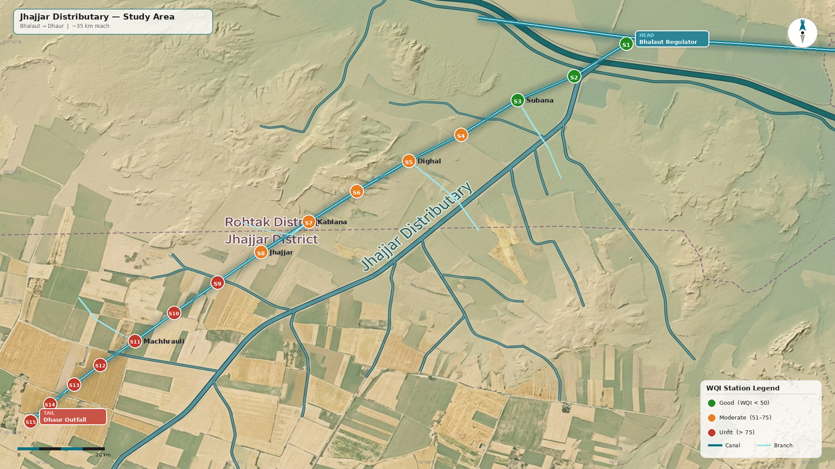
Selected Study Area: Jhajjar Distributary
Geographical Reach, Canal Hydraulics & Socio-Hydrological Significance
Fig 1: Jhajjar Distributary Canal Network Alignment
• Canal Alignment & Reach: Starts at Bhalaut regulator and terminates near Dhaur, spanning approximately 32–35 km in total length.
• Distributary Role: Acts as a branch canal taking off from the Western Yamuna Canal system to distribute water to minor canals and field channels.
• Agricultural Lifeline: Serves as the primary source of irrigation for surrounding command areas; local agriculture is heavily dependent on this canal discharge.
• Domestic & Ecological Uses: Provides drinking water for livestock, supports village washing and domestic chores, and acts as a recharge source for shallow groundwater aquifers along the canal corridor.
• Why Quality Matters: Because canal water directly touches crops, enters the soil profile, and recharges potable groundwater aquifers, establishing an accurate WQI is essential for safeguarding regional food and water security.
GEOGRAPHICAL & FUNCTIONAL PROFILE

Slide 8
Calculation Methodology: WQI and IWQI
Mathematical Formulations for Drinking and Irrigation Indices
Step 1: Unit Weight Calculation (Wn)
Wn = K / Sn
Where K = 1 / Σ(1 / Sn)
K is the proportionality constant ensuring ΣWn = 1.
Step 2: Sub-Index / Quality Rating (Qn)
Qn = 100 × (Vn - Vi) / (Sn - Vi)
Sn = Permissible standard value
Vn = Measured parameter concentration
Vi = Ideal value (Vi = 0 for all parameters, except pH = 7.0).
Step 3: Composite Index Aggregation
WQI = Σ(Qn × Wn) / ΣWn
Synthesizes all individual sub-indices into a single dimensionless water quality score.
Sodium Adsorption Ratio (SAR)
SAR = Na⁺ / √[(Ca²⁺ + Mg²⁺) / 2]
Assesses sodium alkali hazard and risk of soil deflocculation.
Sodium Percentage (Na %)
Na % = [(Na⁺ + K⁺) × 100] / (Ca²⁺ + Mg²⁺ + Na⁺ + K⁺)
Evaluates soil permeability reduction potential.
Magnesium Hazard (MH)
MH = [Mg²⁺ × 100] / (Ca²⁺ + Mg²⁺)
Measures soil crusting and alkalinity from magnesium buildup.
Kelley's Ratio (KR)
KR = Na⁺ / (Ca²⁺ + Mg²⁺)
Values > 1.0 indicate excess sodium hazard for agricultural crops.
*(Note: All ionic concentrations in SAR, Na%, MH, and KR are expressed in meq/L)*
WATER QUALITY INDEX (DRINKING WQI)
IRRIGATION INDICES (IWQI SUITE)

Slide 9
WQI and IWQI Limits & Classification Scales
Standardized Water Quality Categorization Matrices
DRINKING WQI CLASSIFICATION
IRRIGATION INDICES CLASSIFICATION
WQI Range | Water Quality Class
0–25 | Excellent
26–50 | Good
51–75 | Moderately poor
76–100 | Very poor
> 100 | Unfit for drinking
Irrigation Index | Range Threshold | Suitability Class
Sodium % (Na %) | < 60 | Suitable
Sodium % (Na %) | > 60 | Unfit
SAR | < 10 | Excellent
SAR | 10–18 | Good
SAR | 18–26 | Doubtful
SAR | > 26 | Unfit
Magnesium Hazard (MH) | < 50 | Suitable
Magnesium Hazard (MH) | > 50 | Unfit
Kelley's Ratio (KR) | < 1 | Suitable
Kelley's Ratio (KR) | > 1 | Unfit

Slide 10
Project Progress & Future Roadmap
Current Status and Upcoming Laboratory Milestones
• Studied all 12 physicochemical water quality parameters and their health/toxicological significance.
• Mastered analytical testing procedures (Titration, Flame Photometry, UV-Vis Spectrophotometry).
• Conducted extensive regional reconnaissance and finalized the Jhajjar Distributary (Bhalaut to Dhaur) as the primary study reach.
• Formulated the mathematical framework for WQI and IWQI calculations.
• Demarcating GPS-referenced sampling locations along head, middle, and tail reaches of the distributary.
• Procuring pre-washed polypropylene bottles and field reagents for sample preservation.
• Scheduling coordinated sample collection drives across the canal command area.
• Execute comprehensive chemical testing of all water samples in the environmental engineering laboratory.
• Calculate WQI and IWQI scores for all sampling stations.
• Assess spatial water quality trends across the distributary and establish potability/irrigation suitability benchmarks.
• Compile final report and presentation of findings for engineering mitigation.
COMPLETED
IN PROGRESS
NEXT PHASES

